Slide 1
Networks and cybersecurity 1
Intrusion Detection systems, firewalls and honeypots

Slide 2
roadmap
Part 1: Intrusion Detection Systems
Part 2: Firewalls
Part 3: Honeypots
Why use honeypots
Introduction to Snort
Basics of firewalls
Hands-on: Running a real IDS
Writing firewall rules
Hands-on: inspecting a real firewall
Honeypot projects and dataset exploration
Honeypot deployment and issues
Defining Intrusions
How IDSes and IPSes work

Slide 3
Intrusion Detection System
“With so much advancement in hacking, if attackers try hard enough, they will eventually succeed in infiltrating the system. This makes it important to monitor what is taking place on a system and look for suspicious behavior. Intrusion detection systems do just that.”

Slide 4
What is an intrusion
Any event that threatens the confidentiality, integrity or availability of information or an information system.

Slide 5
Characteristic of a systems which are not under attack
The actions of users and processes generally conform to a statistically predictable pattern.
The actions of users and processes do not include sequences of commands to subvert the security policy of the system.
The actions of processes conform to a set of specifications describing actions that the processes are allowed to do (or not allowed to do).
Systems under attack fail to meet at least one of these characteristics.

Slide 6
Example
If the goal is to put in a backdoor, the intruder may modify a system configuration file or program. If the attacker enters the system as a non-privileged user, he or she must acquire system privileges to change the files. The non-privileged user may not be a user who normally acquires system privileges (characteristic 1). The techniques used to acquire those privileges may involve sequences of commands designed to violate the security policy of the system (characteristic 2). If they do not, the alterations in the system files may introduce elements that cause processes to act in ways that violate specifications (characteristic 3).
If the attacker modifies a user file, processes executing on behalf of that user can now behave in abnormal ways, such as allowing network connections from sites not able to connect earlier, or by executing commands that the user did not execute before (characteristic 1). The commands may subvert the security policy, thereby gaining system privileges for the user—and the attacker (characteristic 2).

Slide 7
Examples of intrusions
Performing a remote root compromise of an e-mail server
Defacing a Web server
Guessing and cracking passwords
Copying a database containing credit card numbers
Viewing sensitive data, including payroll records and medical information, without authorization
Running a packet sniffer on a workstation to capture usernames and passwords
Using a permission error on an anonymous FTP server to distribute pirated software and music files
Dialing into an unsecured modem and gaining internal network access
Posing as an executive, calling the help desk, resetting the executive’s e-mail password, and learning the new password
Using an unattended, logged-in workstation without permission

Slide 8
Intruder behavior pattern (1)
The techniques and behavior patterns of intruders are constantly shifting, to exploit newly discovered weaknesses and to evade detection and countermeasures.
Intruders typically follow one of a number of recognizable behavior patterns, and these patterns typically differ from those of ordinary users.

Slide 9
Intruder behavior pattern (2)

Slide 10
Intrusion Detection Systems
Intrusions requires an abnormal use of normal commands or instructions, so security violations can be detected by looking for abnormalities.
These abnormalities includes deviation from usual actions, execution of actions that lead to break-ins and actions inconsistent with the specifications of privileged programs.
An automated system that detect such abnormalities is called Intrusion Detection System (IDS).

Slide 11
Goals of IDS
Detect a wide variety of intrusions
Detect intrusions in a timely fashion
Present the analysis in a simple, easy-to-understand format
Be accurate
Notes:
1. Detect a wide variety of intrusions. Intrusions from within the site, as well
as those from outside the site, are of interest. Furthermore, both known
and previously unknown attacks should be detected. This suggests a
mechanism for learning or adapting to new types of attacks or to changes
in normal user activity.
2. Detect intrusions in a timely fashion. “Timely” here need not be in real
time. Often, it suffices to discover an intrusion within a short period of
time. Real-time intrusion detection raises issues of responsiveness. If
every command and action must be analyzed before it can be executed,
only a very simple analysis can be done before the computer (or network)
being monitored becomes unusable. On the other hand, in all but a few
rare cases, determining that an intrusion took place a year ago is probably
useless.
3. Present the analysis in a simple, easy-to-understand format. Ideally, this
should be a light that glows green for no detected intrusions and that
changes to red when an attack is detected. Unfortunately, intrusions are
rarely this clear-cut, so intrusion detection mechanisms must present more
complex data to a site security officer. The security officer determines what
action (if any) to take. Because intrusion detection mechanisms may
monitor many systems (not just one), the user interface is of critical
importance. This leads to the next requirement.
4. Be accurate. A false positive occurs when an intrusion detection system
reports an attack, but no attack is underway. False positives reduce
confidence in the correctness of the results as well as increase the amount
of work involved. However, false negatives (occurring when an intrusion
detection system fails to report an onging attack) are worse, because the
purpose of an intrusion detection system is to report attacks. The goal of
an intrusion detection system is to minimize both types of errors.

Slide 12
Models of IDS
Intrusion detection systems determine if actions constitute intrusions on the basis of one or more models of intrusion
A model classifies a sequence of states or actions, or a characterization of states or actions, as “good” (no intrusions) or “bad” (possible intrusions)
Two main types of Models
Anomaly Models
Misuse Models (signature based)

Slide 13
Anomaly Modeling
Anomaly detection analyzes a set of characteristics of the system and compares their behavior with a set of expected values. It reports when the computed statistics do not match the expected measurements.
Anomaly detection uses the assumption that unexpected behavior is evidence of an intrusion.
Types
Threshold based Models
Statistical Models
Markov models

Slide 14
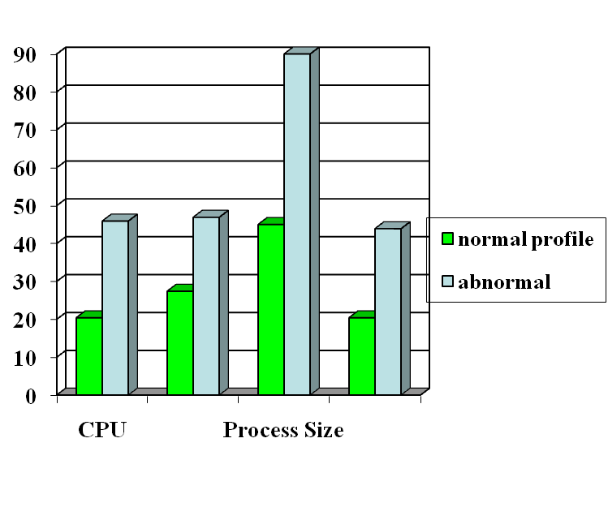
Anomaly Detection
probable intrusion
activity measures
Define a profile describing “normal” behavior, then detects deviations.
Any problem ?
Relatively high false positive rates
Anomalies can just be new normal activities.
Anomalies caused by other element faults
E.g., router failure or misconfiguration, P2P misconfig
Which method will detect DDoS SYN flooding ?
Notes:
The two axis not shown are IO and page fault.

Slide 15
Misuse Modeling
Misuse detection determines whether a sequence of instructions being executed is known to violate the site security policy being executed. If so, it reports a potential intrusion.
In some contexts, the term “misuse” refers to an attack by an insider or authorized user.
Modeling of misuse requires a knowledge of system vulnerabilities or potential vulnerabilities that attackers attempt to exploit.
The intrusion detection system incorporates this knowledge into a rule set. Misuse modeling is also known as “rule-based detection.”
Misuse-based intrusion detection systems often use expert systems to analyze the data and apply the rule set.
Signature-based is an alternate name for this; this includes behavioural signatures (rules/patterns).

Slide 16
Misuse Detection
pattern matching
Intrusion Patterns:
Sequences of system calls, patterns of network traffic, etc.
intrusion
activities
Example: if (traffic contains “x90+de[^\r\n]{30}”) then “attack detected”
Problems?
Can’t detect new attacks

Slide 17
Architecture of IDS
An intrusion detection system is like an automated auditing mechanism
It has three parts
Agent: Corresponds to the logger.
It acquires information from a target.
Director: Corresponds to the analyzer.
It analyzes the data from the agents as required.
Uses an analysis engine to determine if an attack is underway.
it is usually run on a separate system.
The director must correlate information from multiple logs.
Notifier:
The notifier accepts information from the director and takes the appropriate action.
Determines whether, and how, to notify the requisite entity.

Slide 19
Types of IDS
Depending upon data collection methods.
Host based IDS: Use system and application logs to obtain records of events, and analyze them to determine what to pass to the director.
Network Based IDS: use a variety of devices and software to monitor network traffic.
Hybrid IDS: An aggregate of both HIDS and NIDS.
Also referred as Distributed intrusion detection system (DIDS).
Notes:
Host-based agents usually use system and application logs to obtain records of events, and analyze them to determine what to pass to the director. The events to look for, and to analyze, are determined by the goals of the intrusion detection mechanism. The logs may be security-related logs (such as BSM and the Windows NT logs A variant of host-based information gathering occurs when the agent generates its own information. Policy checkers do this. They analyze the state of the system, or of some objects in the system, and treat the results as a log (to reduce and forward). However, these agents are usually somewhat complex, and a fundamental rule of secure design is to keep software simple, usually by restricting its function to ne task. This arrangement violates that rule. So, the policy checker usually logs its output, and the agent simply analyzes that log just as it would analyze any other log.
2. Network-based agents use a variety of devices and software to monitor network traffic. This technique provides information of a different flavor than host-based monitoring provides. It can detect network-oriented attacks, such as a denial of service attack introduced by flooding a network. It can monitor traffic for a large number of hosts. It can also examine the contents of the traffic itself (called content monitoring). Network-based agents may use network sniffing to read the network traffic. In this case, a system provides the agent with access to all network traffic passing that host. If the medium is point-to-point (such as a token ring network), the agents must be distributed to obtain a complete view of the network messages. If the medium is a broadcast medium (such as Ethernet), typically only one computer needs to have the monitoring agent. Arranging the monitoring agents so as to minimize the number required to provide complete network coverage is a difficult problem. In general, the policy will focus on intruders entering the network rather than on insiders. In this case, if the network has a limited number of points of access, the agents need to monitor only the traffic through those points. If the computers controlling those entry points do extensive logging on the network traffic that they receive, the networkbased information gathering is in effect reduced to host-based information gathering.
Monitoring of network traffic raises several significant issues. The critical issue is that the analysis software must ensure that the view of the network traffic is
exactly the same as at all hosts for which the traffic is intended. Furthermore, if the traffic is end-to-end enciphered, monitoring the contents from the network is not possible.

Slide 20


Host-Based IDSs
Use OS auditing and monitoring mechanisms to find applications taken over by attacker
Log all relevant system events (e.g., file/device accesses)
Monitor shell commands and system calls executed by user applications and system programs
Pay a price in performance if every system call is filtered
Problems:
User dependent: install/update IDS on all user machines!
If attacker takes over machine, can tamper with IDS binaries and modify audit logs
Only local view of the attack
Notes:
BSM: Basic Security Module

Slide 21
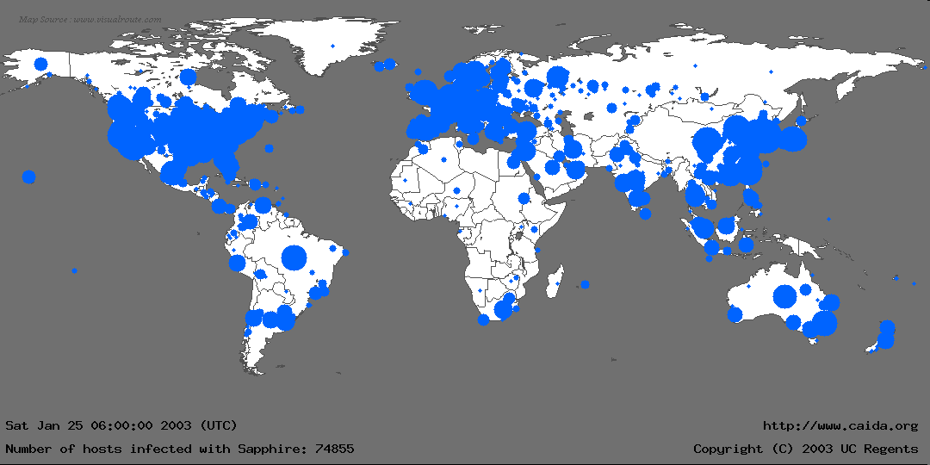
The Spread of Sapphire/Slammer Worms
Notes:
In the first 30 minutes of Sapphire’s spread, we recorded nearly 75,000 unique infections. As we will detail later, most of these infections actually occurred within 10 minutes.
This graphic is more for effect rather than technical detail: We couldn’t determine a detailed location for all infections, and the diameter of each circle is proportional to the lg() of the number of infections, underrepresenting larger infections. Nevertheless, it gives a good feel for where Sapphire spread.
We monitored the spread using several “Network Telescopes”, address ranges where we had sampled or complete packet traces at single sources. We also used the D-shield distributed intrusion detection system to determine IPs of infected machines, but we couldn’t use this data for calculating the scanning rate.

Slide 22


Network Based IDSs
Internet
Gateway routers
Our network
Host based
detection
At the early stage of the worm, only limited worm samples.
Host based sensors can only cover limited IP space, which has scalability issues. Thus they might not be able to detect the worm in its early stage.

Slide 23


Network IDSs
Deploying sensors at strategic locations
For example, Packet sniffing via tcpdump at routers
Inspecting network traffic
Watch for violations of protocols and unusual connection patterns
Look into the packet payload for malicious code
Limitations
Cannot execute the payload or do any code analysis !
Even DPI gives limited application-level semantic information
Record and process huge amount of traffic
May be easily defeated by encryption, but can be mitigated with encryption only at the gateway/proxy
Notes:
Problems: mainly accuracy

Slide 24
Key Metrics of IDS/IPS
Algorithm
Alarm: A; Intrusion: I
Detection (true alarm) rate: P(A|I)
False negative rate P(¬A|I)
False alarm (aka, false positive) rate: P(A|¬I)
True negative rate P(¬A|¬I)
Architecture
Throughput of NIDS, targeting 10s of Gbps
E.g., 32 nsec for 40 byte TCP SYN packet
Resilient to attacks

Slide 25
Architecture of Network IDS
Signature matching
(& protocol parsing when needed)
Protocol identification
TCP reassembly
Packet capture libpcap
Packet stream

Slide 26
Firewall/Net IPS VS Net IDS
Firewall/IPS
Active filtering
Fail-close
Network IDS
Passive monitoring
Fail-open
IDS
FW
Notes:
Protection is not free/cheap. For example, an intrusion detection system (IDS) needs to analyze each packet. This requires a lot of computing power, usually a dedicated high-end workstation. If the IDS is real-time then its response time must be short.
When there is insufficient resources, some protection mechanisms will simply not let data in (fail-close). For example, a firewall, which filters each packet, will simply drop packets when it is overloaded. The dropped packet will not be able to reach beyond the firewall into the internal network. The user experience may not be a happy one because of data loss. However, other protection mechanisms will check/analyze as much as they can but will effectively let all data (fail-open) when there is insufficient resources. For example, an IDS, which simply copies a packet and analyzes it (while the packet continues to reach its target), may only be able to check a packet after a lengthy delay when it is overloaded, letting the packet to complete its potentially malicious actions.
When assessing the protection mechanisms, we will develop models and evaluate under what conditions they will fail-close or fail-open.

Slide 27
Related Tools for Network IDS (I)
While not an element of Snort, wireshark (used to be called Ethereal) is the best open source GUI-based packet viewer
www.wireshark.org offers:
Support for various OS: windows, Mac OS.
Included in standard packages of many different versions of Linux and UNIX
For both wired and wireless networks

Slide 28
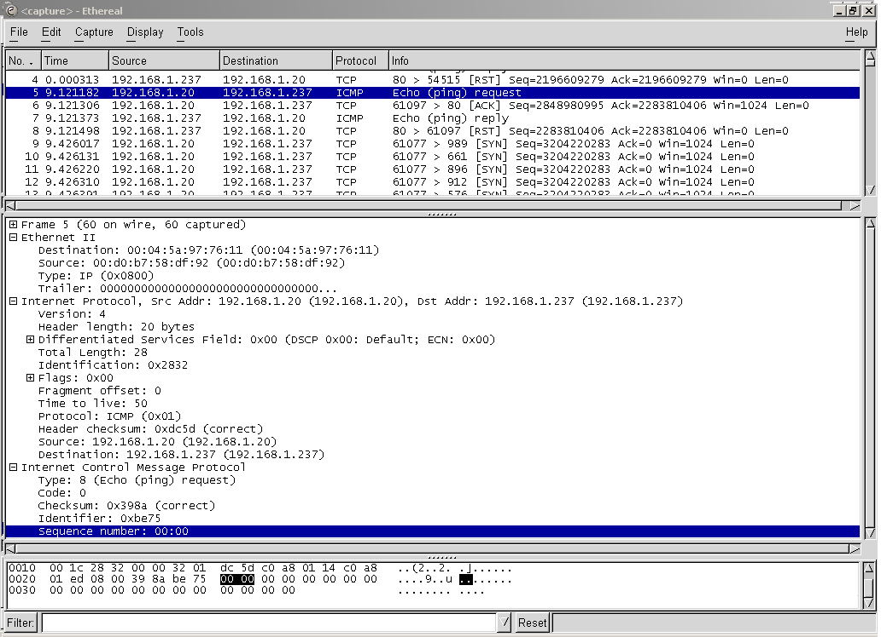

Slide 29
Related Tools for Network IDS (II)
Also not an element of Snort, tcpdump is a well-established CLI packet capture tool
www.tcpdump.org offers UNIX source
http://www.winpcap.org/windump/ offers windump, a Windows port of tcpdump

Slide 30
Intrusion prevention systems
Intrusion detection systems detect and report intrusions
Intrusion prevention systems can be configured with rules that also prevent intrusions
E.g. if attack traffic is seen originating from a particular port, block the port
Or block traffic to/from a particular IP
Blacklist enforcement – block communication to particular IPs or URLs.

Slide 31
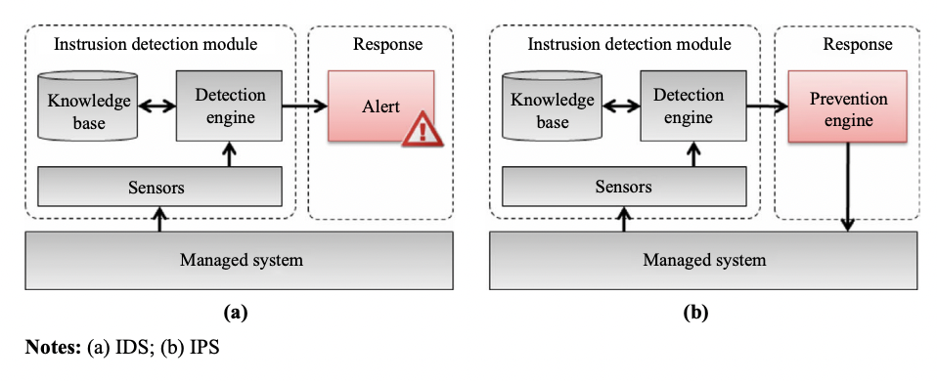
Intrusion prevention systems
An IPS can respond to a detected threat in several ways:
it can reconfigure other security controls in systems such as a firewall or router to block future attacks;
it can remove malicious content of an attack in network traffic to filter out the threatening packets; or
it can (re-)configure other security and privacy controls in browser settings to prevent future attacks.

Slide 32
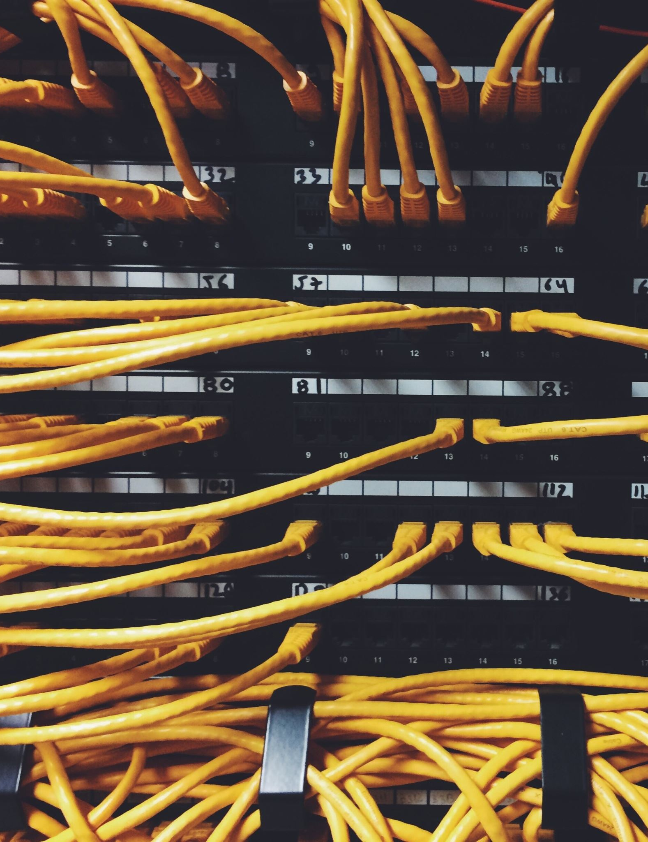
Firewalls

Slide 33
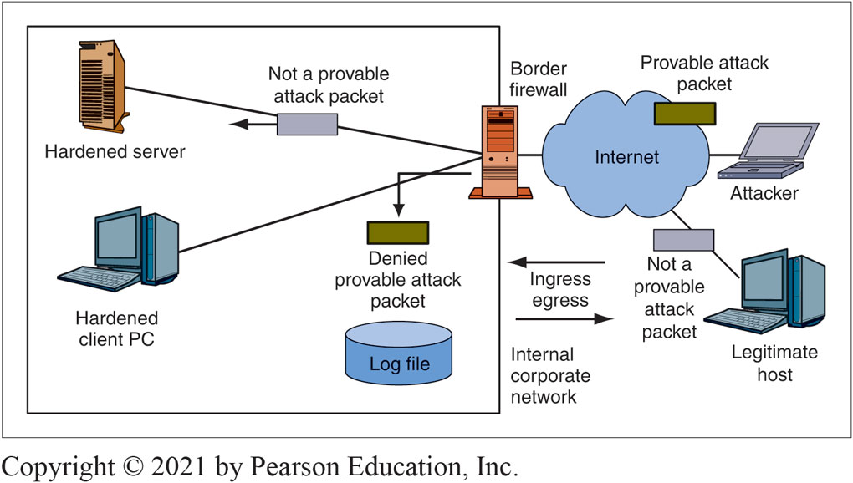
Basic Firewall Operation
Notes:
This figure shows that a firewall examines each packet passing through it. If the packet is a provable attack packet, the firewall drops the packet. If the packet is not a provable attack packet, the firewall passes the packet on to its destination. In firewalls, this is called a pass/deny decision.

Slide 34
Basic Firewall Operation (1 of 4)
The Problem
If a firewall cannot filter all of the traffic passing through it, it drops packets it cannot process
This is secure because it prevents attack packets from getting through
But it creates a self-inflicted denial-of-service attack by dropping legitimate traffic
6-34

Slide 35
Basic Firewall Operation (2 of 4)
Firewall Capacity
Firewalls must have the capacity to handle the incoming traffic volume
Some can handle normal traffic but cannot handle traffic during heavy attacks!
They must be able to handle incoming traffic at wire speed—the maximum speed of data coming into each port
6-35

Slide 36
Basic Firewall Operation (3 of 4)
Processing Power Is Increasing Rapidly
As processing power increases, more sophisticating filtering methods should become possible
We can even have unified threat management (UTM), in which a single firewall can use many forms of filtering, including antivirus filtering and even spam filtering. (Traditional firewalls do not do these types of application-level malware filtering.)
However, increasing traffic is soaking up much of this increasing processing power

Slide 37
Basic Firewall Operation (4 of 4)
Firewall Filtering Mechanisms
There are many types
We will focus most heavily on the most important firewall filtering method, stateful packet inspection (SPI)
Single firewalls can use multiple filtering mechanisms, most commonly, SPI with other secondary filtering mechanisms
6-37

Slide 38
Static Packet Filtering (1 of 5)
Static Packet Filtering
This was the earliest firewall filtering mechanism
Limits
Examines packets one at a time, in isolation
Only looks at some internet and transport headers
Consequently, unable to stop many types of attacks
6-38

Slide 39
Static Packet Filtering (2 of 5)
Inspects Packets One at a Time, in Isolation
If it receives a packet containing a SYN/ACK segment, this may be a legitimate response to an internally initiated SYN segment
The firewall must pass packets containing these segments, or internally initiated communications cannot exist
6-39

Slide 40
Static Packet Filtering (3 of 5)
Inspects Packets One at a Time, in Isolation
However, this SYN/ACK segment could be an external attack
It could be sent to elicit an RST segment confirming that there is a victim at the IP address to which the SYN/ACK segment is sent
A static packet filtering firewall cannot stop this attack
6-40

Slide 41
Static Packet Filtering (4 of 5)
Static Packet Filtering Can Stop Certain Attacks Very Efficiently
Incoming I C M P Echo packets and other scanning probe packets
Outgoing responses to scanning probe packets
Packets with spoofed I P addresses (e.g., incoming packets with the source I P addresses of hosts inside the firm)
Packets that have nonsensical field settings, such as a T C P segment with both the S Y N and F I N bits set
6-41

Slide 42
Static Packet Filtering (5 of 5)
Market Status
No longer used as the main filtering mechanism for border firewalls
May be used as a secondary filtering mechanism on main border firewalls
6-42

Slide 43
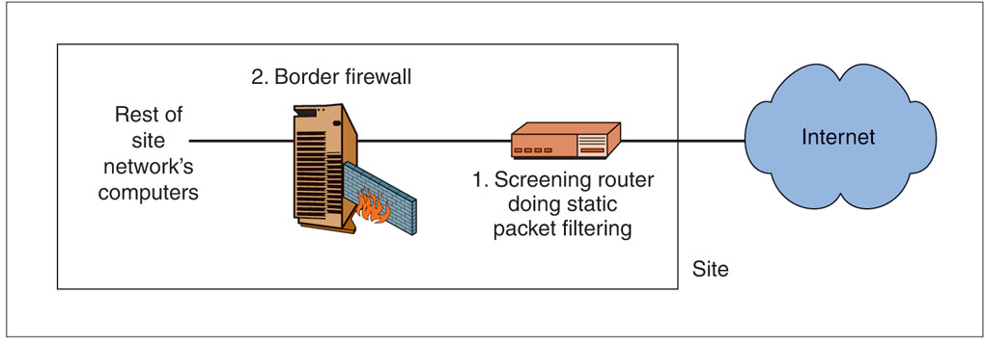
Main Border Firewall and Screening Router That Uses Static Packet Filtering
Market Status
Also may be implemented in border routers, which lie between the Internet and the firewall
Stops simple, high-volume attacks to reduce the load on the main border firewall
6-43

Slide 44
Stateful Packet Inspection (1 of 7)
Nearly all corporate border firewalls today use the stateful packet inspection (SPI) filtering method
SPI focuses on connections
Persistent conversations between different programs on different computers

Slide 45
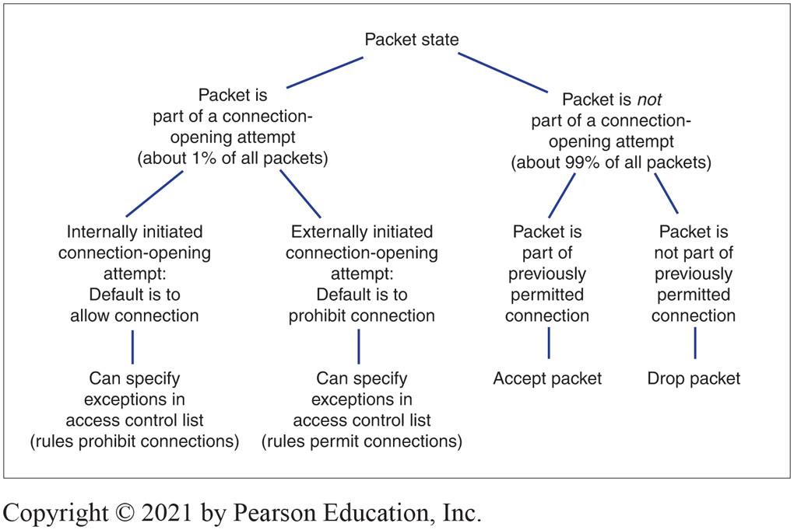
States in a Connection
6-45
Notes:
The concept of states is central to SPI filtering. Figure 6-5 illustrates a simple connection in which there are only two states.
First, there is an opening state, when the two applications agree to open a connection.
Afterward, the two applications enter the ongoing communication state. For most connections, traffic is dominated by exchanges during the ongoing communication state. The two applications communicate back and forth using the same port numbers and other conditions.

Slide 46
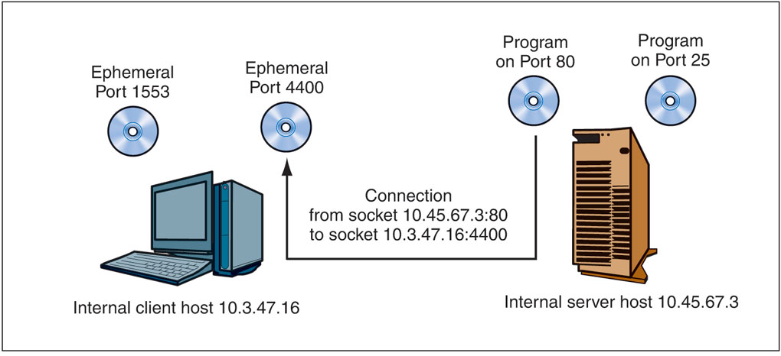
Connection and Socket
Notes:
SPI focuses on connections between programs on different hosts. In networking, a connection is represented by its socket, which designates a specific program (designated by a port number) on a specific computer (IP address). A socket is written as an IP address, a colon, and a port number—for example, 10.3.47.16:4400. As Figure 6-6 shows, a connection is a link between programs on different machines. It consists of two sockets—an internal socket and an external socket.

Slide 47
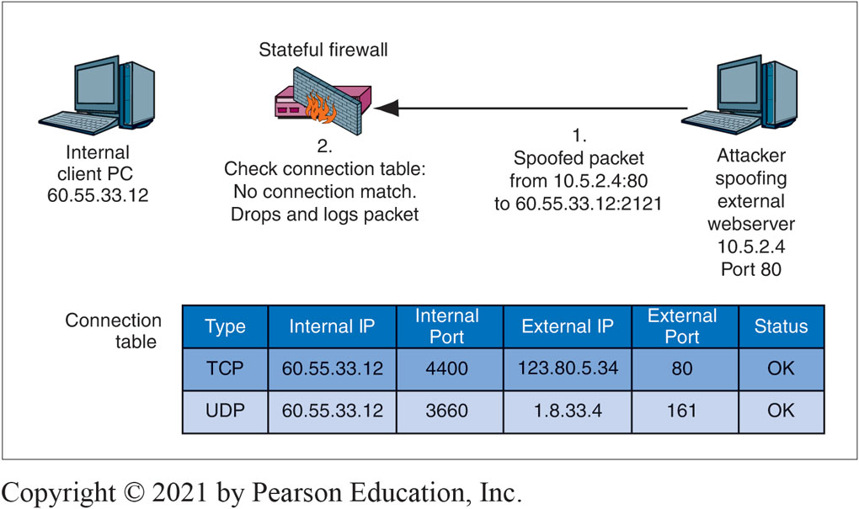
Stateful Packet Inspection for a Packet That Does Not Attempt to Open a Connection II
Notes:
Suppose that an attacker’s host sends a packet with the IP source address 10.5.2.4 (a spoofed IP address) and the TCP destination port 80. This is not a connection-opening attempt. (The SYN flag is not set in the TCP segment.) In Figure 6-8, we see that this packet does not match any row in the connection table. The firewall drops and logs the packet.

Slide 48
Stateful Packet Inspection (2 of 7)
Access Control List Operation
An ACL is a series of rules for allowing or disallowing connections
The rules are executed in order, beginning with the first
If a rule does not apply to the connection-opening attempt, the firewall goes to the next ACL rule
If the rule does apply, the firewall follows the rule, and no further rules are executed
If the firewall reaches the last rule in the ACL, it follows that rule
6-48

Slide 49
Stateful Packet Inspection (3 of 7)
Ingress ACL’s Purpose
The default behavior is to drop all attempts to open a connection from the outside
All ACL rules except for the last give exceptions to the default behavior under specified circumstances
The last rule applies the default behavior to all connection-opening attempts that are not allowed by earlier rules to be executed by this last rule
6-49

Slide 50
Stateful Packet Inspection (4 of 7)
Simple Ingress ACL with Three Rules
If TCP destination port = 80 or TCP destination port = 443, then Allow Connection [Permits connection to ALL internal webservers]
If TCP destination port = 25 AND IP destination address = 60.47.3.35, then Allow Connection [Permits connections to a SINGLE internal mail server]
Disallow ALL Connections [Disallows all other externally initiated connections; this is the default behavior]
6-50

Slide 51
Stateful Packet Inspection (5 of 7)
Low Cost
Most packets are not part of packet-opening attempts
These can be handled very simply and therefore inexpensively
Connection-opening attempt packets are more expensive processes but are rare
6-51

Slide 52
Stateful Packet Inspection (6 of 7)
Safety
Attacks other than application-level attacks usually fail to get through SPI firewalls
In addition, SPI firewalls can use other forms of filtering when needed
6-52

Slide 53
Stateful Packet Inspection (7 of 7)
Dominance
The combination of high safety and low cost makes SPI firewalls extremely popular
Nearly all main border firewalls today use stateful packet inspection
6-53

Slide 54
Application Proxy Firewalls and Content Filtering (1 of 4)
Protections for Internal Clients against Malicious Webservers
URL blacklists for known attack sites
Protection against some or all scripts in webpages
The disallowing of HTTP response messages with prohibited MIME types that indicate malware
6-54

Slide 55
Application Proxy Firewalls and Content Filtering (2 of 4)
Protections against Misbehaving Internal Clients
Disallowing the HTTP POST method, which can be use to send out sensitive files
6-55

Slide 56
Application Proxy Firewalls and Content Filtering (3 of 4)
Protections for Internal Webservers against Malicious Clients
Disallow HTTP POST methods, which could allow malware files to be placed on the server
Indications of SQL injection attacks
6-56

Slide 57
Application Proxy Firewalls and Content Filtering (4 of 4)
Automatic Protections
The hiding of internal host IP addresses from sniffers
Header destruction
The data link, internet, and transport headers are discarded—along with any attacks they may have contained
Protocol fidelity
If the client or server does not follow the protocol of the indicated port number, communication with the firewall automatically breaks down
6-57

Slide 58
IDS Vs. Firewall
Intrusion Detection Systems (IDSs)
Firewalls drop provable attack packets only
Intrusion detection systems (IDSs) look for suspicious traffic
Sends an alarm message if the attack appears to be serious
Problem: Too many false positives (false alarms)
Problem: Heavy processing requirements because of sophisticated filtering
Packet stream analysis
Often, patterns cannot be seen unless many packets are examined
6-58

Slide 59
IPS VS. Firewall
Intrusion Prevention Systems (IPSs)
Use IDS filtering mechanisms
Application-specific integrated circuits (ASICs) provide the needed processing power
Attack confidence identification spectrum
Somewhat likely,
Very likely,
Provable
Allowed to stop traffic at the high end of the attack confidence spectrum
Firm decides which attacks to stop
6-59

Slide 60
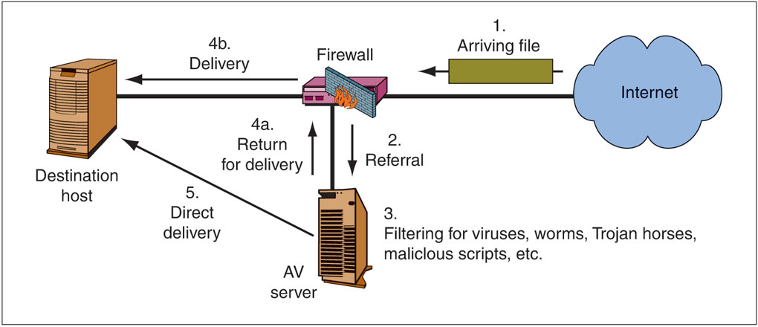
Firewalls and Antivirus Servers
Notes:
Firewalls normally do not do antivirus filtering. However, firewalls and antivirus filtering servers work together closely. All major firewall vendors have protocols for working with antivirus servers. Figure 6-18 illustrates this dynamic.

Slide 61
Antivirus Filtering and Unified Threat Management
Traditional Firewalls
Do not do antivirus filtering
Unified Threat Management (UTM) Firewalls
SPI
Antivirus filtering
VPNs
DoS protection
NAT

Slide 62
Firewall Filtering Problems (1 of 6)
Protecting the Perimeter Is No Longer Possible
There are too many ways to get through the perimeter
6-62

Slide 63
Firewall Filtering Problems (2 of 6)
Avoiding the Border Firewall
Internal attackers are inside the firewall already
Compromised internal hosts are inside the firewall
Wireless LAN drive-by hackers enter through access points that are inside the site
Home notebooks, mobile phones, and media brought into the site
Internal firewalls can address some of these threats
6-63

Slide 64
Firewall Filtering Problems (3 of 6)
Extending the Perimeter
Remote employees must be given access
Consultants, outsourcers, customers, suppliers, and other subsidiaries must be given access
Essentially, all of these tend to use VPNs to make external parties “internal” to your site
6-64

Slide 65
Firewall Filtering Problems (4 of 6)
Most Filtering Methods Use Attack Signature Detection
Each attack has a signature
This attack signature is discovered
The attack signature is added to the firewall
6-65

Slide 66
Firewall Filtering Problems (5 of 6)
Problem
Zero-day attacks are attacks without warning, and occur before a signature is developed
Signature defense cannot stop zero-day attacks
6-66

Slide 67
Firewall Filtering Problems (6 of 6)
Anomaly Detection
Detects an unusual pattern indicating a possible attack
This is difficult, so there are many false positives
Shrinking time needed to define signatures
Anomaly detection is necessary in today’s firewalls
6-67

Slide 68
Honeypots

Slide 69
Introduction
A honeypot is a trap set to detect, deflect, or in some manner counteract attempts at unauthorized use of information systems
They are the highly flexible security tool with different applications for security. They don't fix a single problem. Instead they have multiple uses, such as prevention, detection, or information gathering.
A honeypot is an information system resource whose value lies in unauthorized or illicit use of that resource

Slide 70
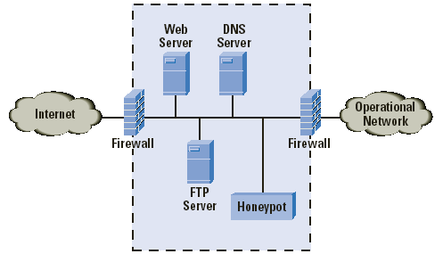
What is a Honey Pot?
A Honey Pot is an intrusion detection technique used to study hackers movements.

Slide 71
What is a Honey Pot?(cont.)
Virtual machine that sits on a network or a client
Goals
Should look as real as possible!
Should be monitored to see if its being used to launch a massive attack on other systems
Should include files that are of interest to the hacker

Slide 72
Classification
By level of interaction
High
Low
By Implementation
Virtual
Physical
By purpose
Production
Research

Slide 73
Interaction
Low interaction Honeypots
They have limited interaction, they normally work by emulating services and operating systems
They simulate only services that cannot be exploited to get complete access to the honeypot
Attacker activity is limited to the level of emulation by the honeypot
Examples of low-interaction honeypots include Specter, Honeyd, and KFsensor

Slide 74
Interaction
High interaction Honeypots
They are usually complex solutions as they involve real operating systems and applications
Nothing is emulated, the attackers are given the real thing
A high-interaction honeypot can be compromised completely, allowing an adversary to gain full access to the system and use it to launch further network attacks
Examples of high-interaction honeypots include Symantec Decoy Server and Honeynets

Slide 75
implementation
Physical
Real machines
Own IP Addresses
Often high-interactive
Virtual
Simulated by other machines that:
Respond to the traffic sent to the honeypots
May simulate a lot of (different) virtual honeypots at the same time

Slide 76
production
Production honeypots are easy to use, capture only limited information, and are used primarily by companies or corporations.

Slide 77
research
Research honeypots are complex to deploy and maintain, capture extensive information, and are used primarily by research, military, or government organizations.
Collect compact amounts of high value information
Discover new Tools and Tactics
Understand Motives, Behavior, and Organization
Develop Analysis and Forensic Skills

Slide 78
Advantages and disadvantages
Small data sets of high value.
Easier and cheaper to analyze the data.
Designed to capture anything thrown at them, including tools or tactics never used before
Require minimal resources
Can collect in-depth information
Conceptually very simple.
Can only track and capture activity that directly interacts with them
All security technologies have risk
Building, configuring, deploying and maintaining a high-interaction honeypot is time consuming
Difficult to analyze a compromised honeypot
High interaction honeypot introduces a high level of risk
Low interaction honeypots are easily detectable by skilled attackers

Slide 79
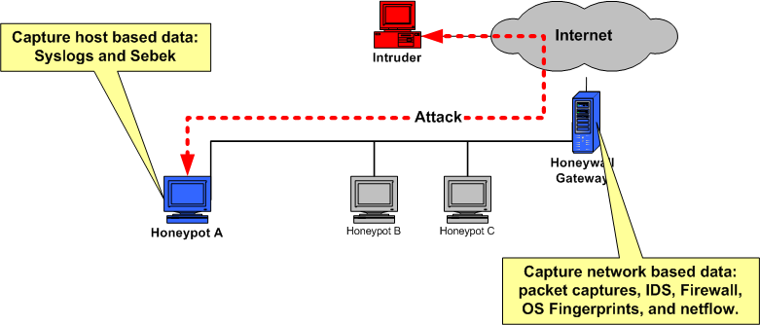
Working of Honeynet – High – interaction honeypot
Honeynet has 3 components:
Data control
Data capture
Data analysis

Slide 80
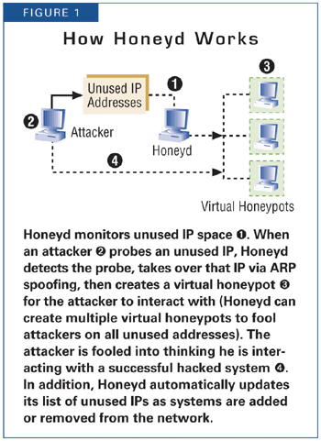
Working of Honeyd – Low – interaction honeypot
Open Source and designed to run on Unix systems
Concept - Monitoring unused IP space

Slide 81
conclusion
Not a solution!
Can collect in depth data which no other technology can
Different from others – its value lies in being attacked, probed or compromised
Extremely useful in observing hacker movements and preparing the systems for future attacks

